Slide 1


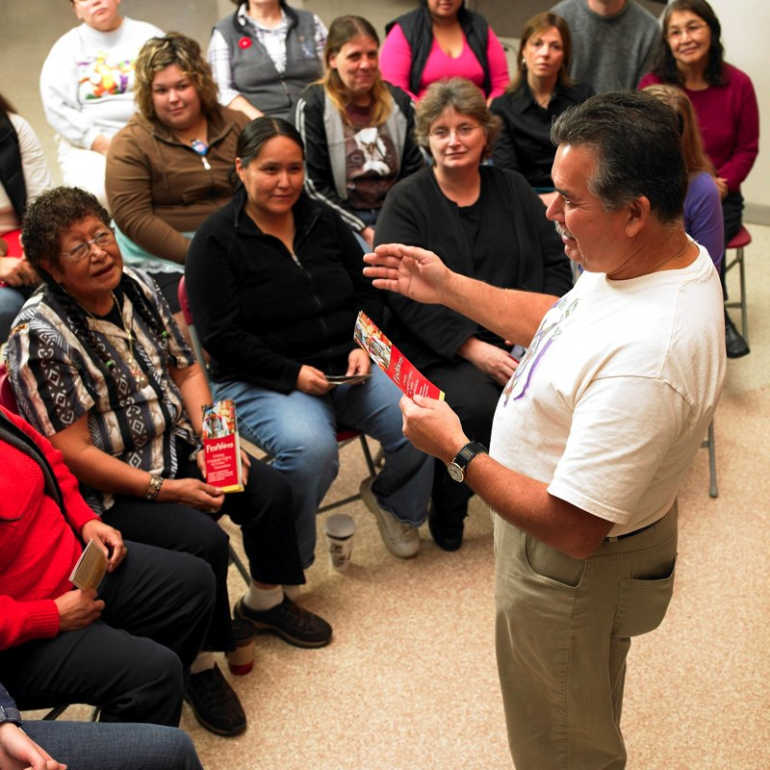
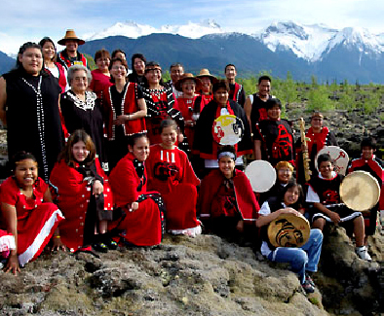
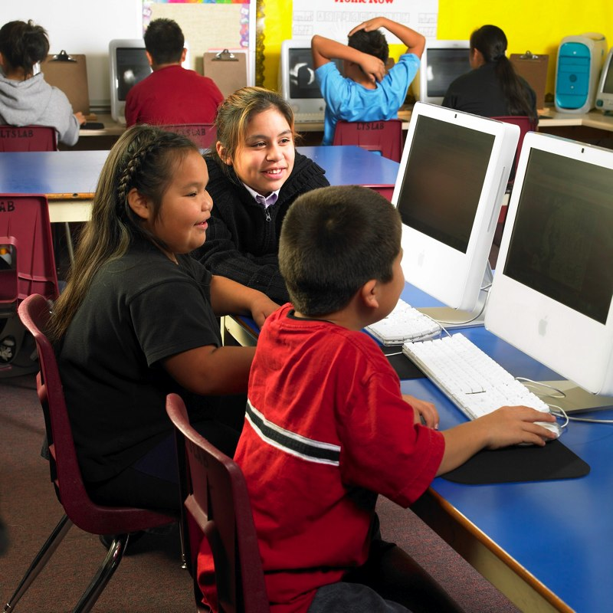
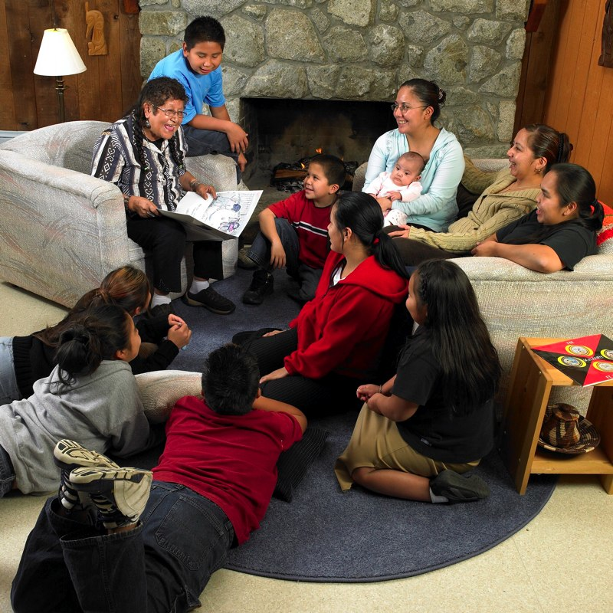

First Peoples’ Cultural Council Language Programs Presenter: Aliana Parker
Optional Image or Row of Images

Slide 2
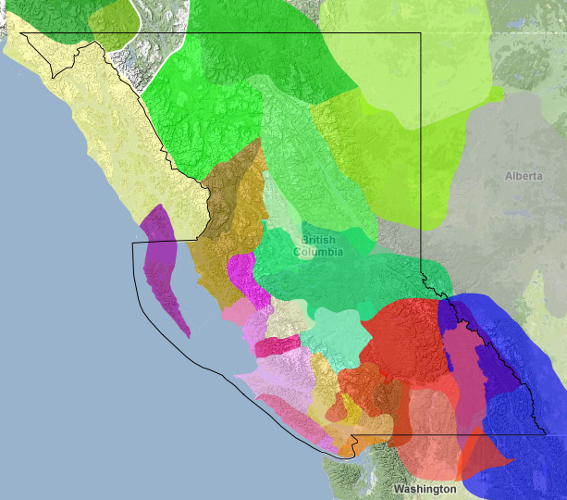
Background
FPCC’s Language Programs support
community-based language revitalization projects
Funding provided through FPCC by:
Ministry of Aboriginal Relations & Reconciliation
New Relationship Trust
First Peoples’ Cultural Foundation
Department of Canadian Heritage
For First Nations communities
and organizations in BC
Notes:
FPCC is unique in Canada
Our legislation supports the creation of the organization and provides us with a mandate
We are the delivery agent for funding for arts, language and FirstVoices
Resource and materials development –
A Guide to Language Policy and Planning for B.C. First Nations Communities
B.C.’s Master-Apprentice Language Program
Artist Grant Proposal Writing Handbook
Advocacy: write papers and publish reports - Report on the Status of BC First Nations Languages

Slide 3
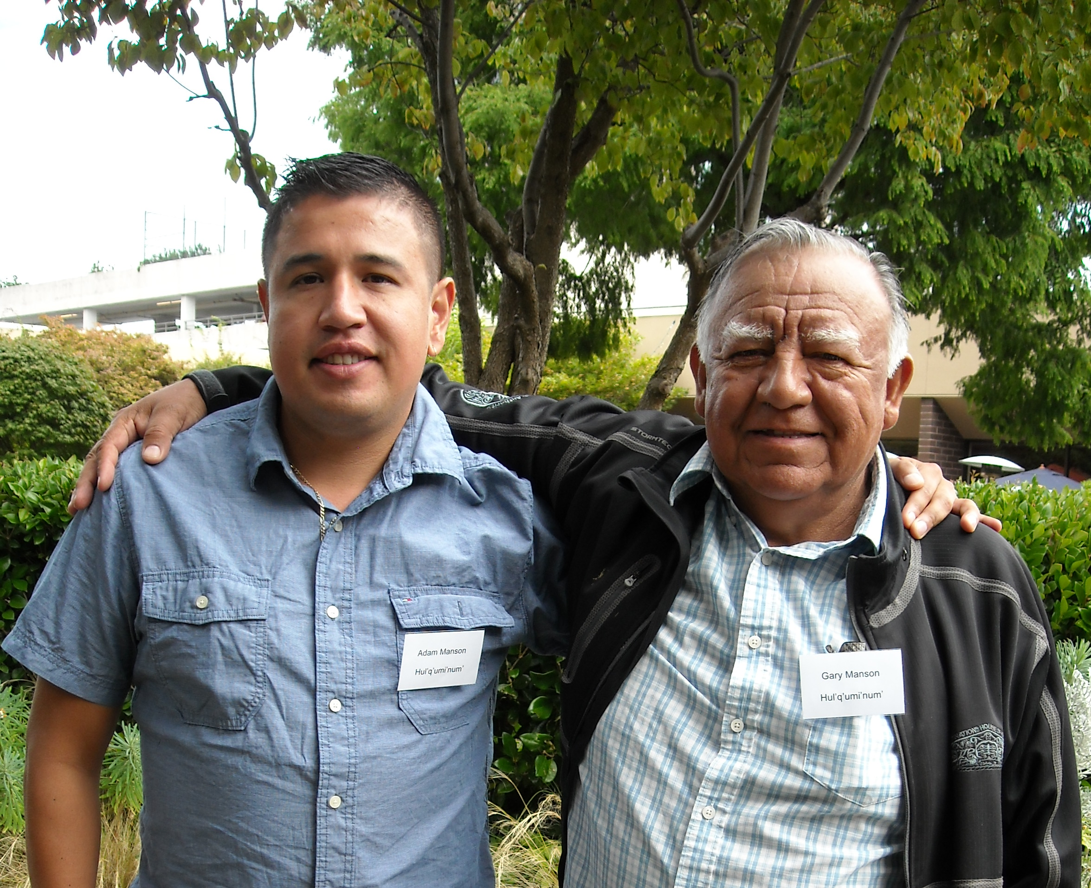
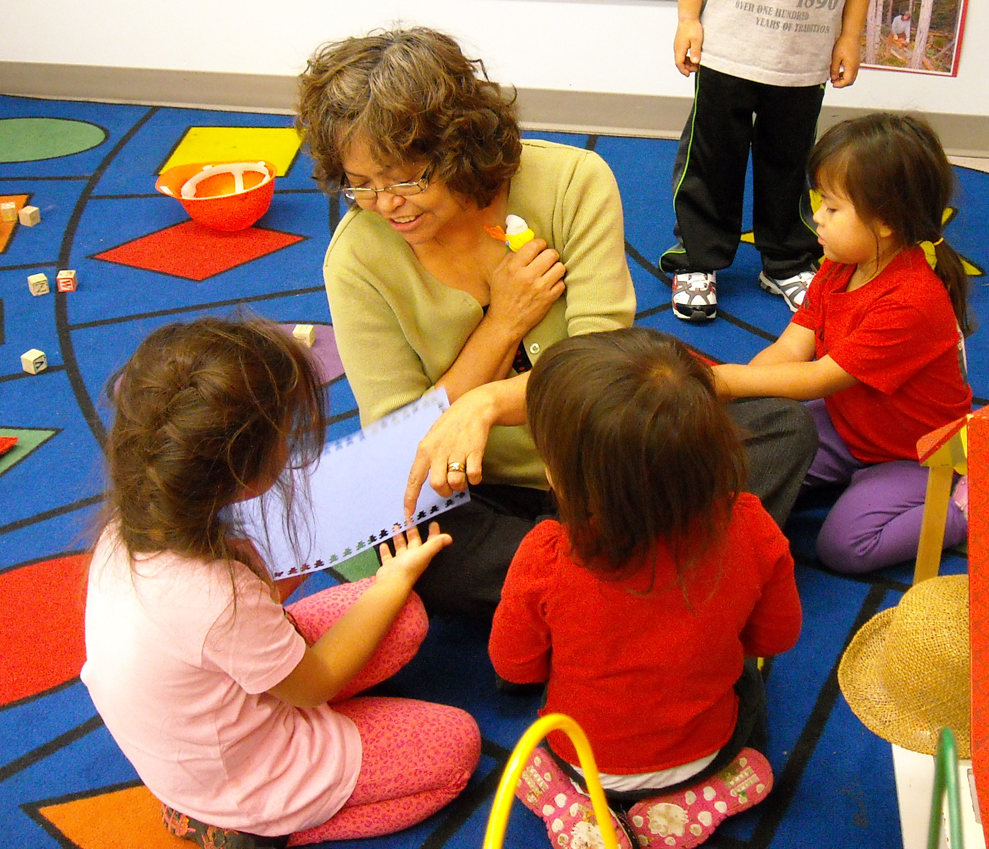
Programs
Mentor-Apprentice Program
One-on-one immersion for adults
Grants: $14,600
Language Nest Program
Immersion programs for children 0 – 5 yrs
Grants: $20,000
Language Revitalization Planning Program
Multi-community strategic planning
Grants: $18,500
Notes:
FPCC is unique in Canada
Our legislation supports the creation of the organization and provides us with a mandate
We are the delivery agent for funding for arts, language and FirstVoices
Resource and materials development –
A Guide to Language Policy and Planning for B.C. First Nations Communities
B.C.’s Master-Apprentice Language Program
Artist Grant Proposal Writing Handbook
Advocacy: write papers and publish reports - Report on the Status of BC First Nations Languages

Slide 4
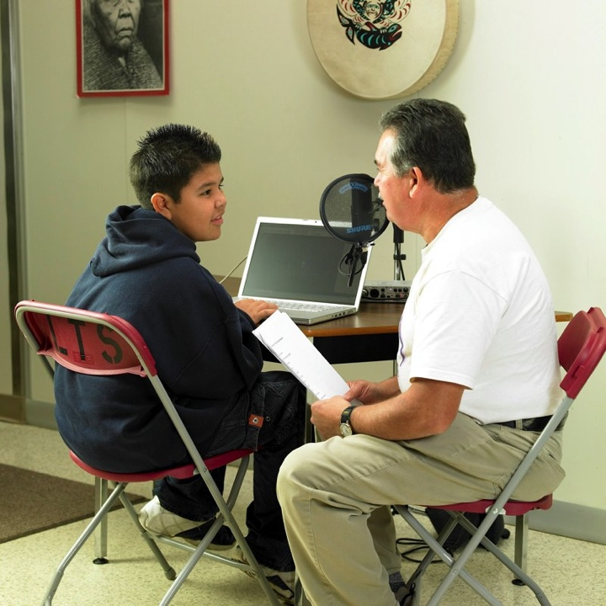
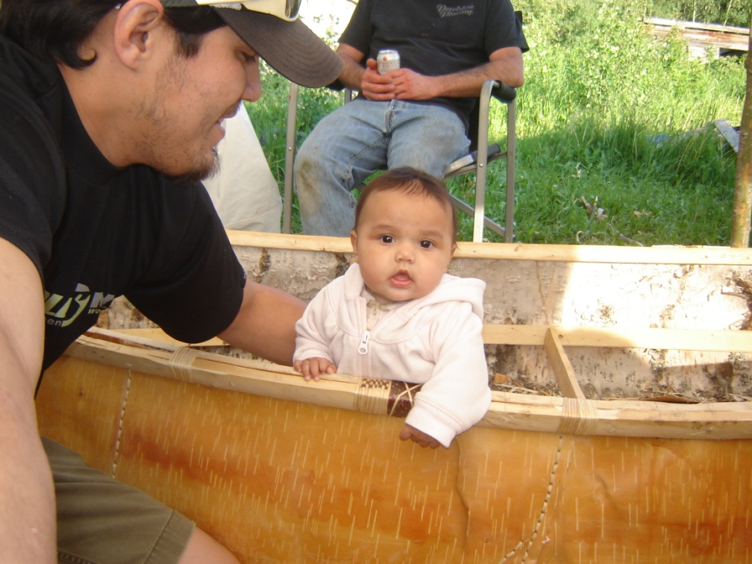

Programs
B.C. Language Initiative (BCLI)
Multiple strategies funded (documentation and fluency-building)
Grants: up to $15,000
Aboriginal Languages Initiative (ALI)
Multiple strategies funded (documentation and fluency-building)
Grants: up to $35,000
FirstVoices
Archive, Tutor or App development
Grants: up to $25,000
Notes:
FPCC is unique in Canada
Our legislation supports the creation of the organization and provides us with a mandate
We are the delivery agent for funding for arts, language and FirstVoices
Resource and materials development –
A Guide to Language Policy and Planning for B.C. First Nations Communities
B.C.’s Master-Apprentice Language Program
Artist Grant Proposal Writing Handbook
Advocacy: write papers and publish reports - Report on the Status of BC First Nations Languages

Slide 5
Criteria
Who can apply:
First Nations communities / bands / organizations
Cultural centres & societies
Individuals (MAP only)
Funding Timeline:
Applications due: Spring 2017
Projects implemented: Summer 2017 – March 2018
Projects completed: March 2018
Notes:
FPCC is unique in Canada
Our legislation supports the creation of the organization and provides us with a mandate
We are the delivery agent for funding for arts, language and FirstVoices
Resource and materials development –
A Guide to Language Policy and Planning for B.C. First Nations Communities
B.C.’s Master-Apprentice Language Program
Artist Grant Proposal Writing Handbook
Advocacy: write papers and publish reports - Report on the Status of BC First Nations Languages

Slide 6
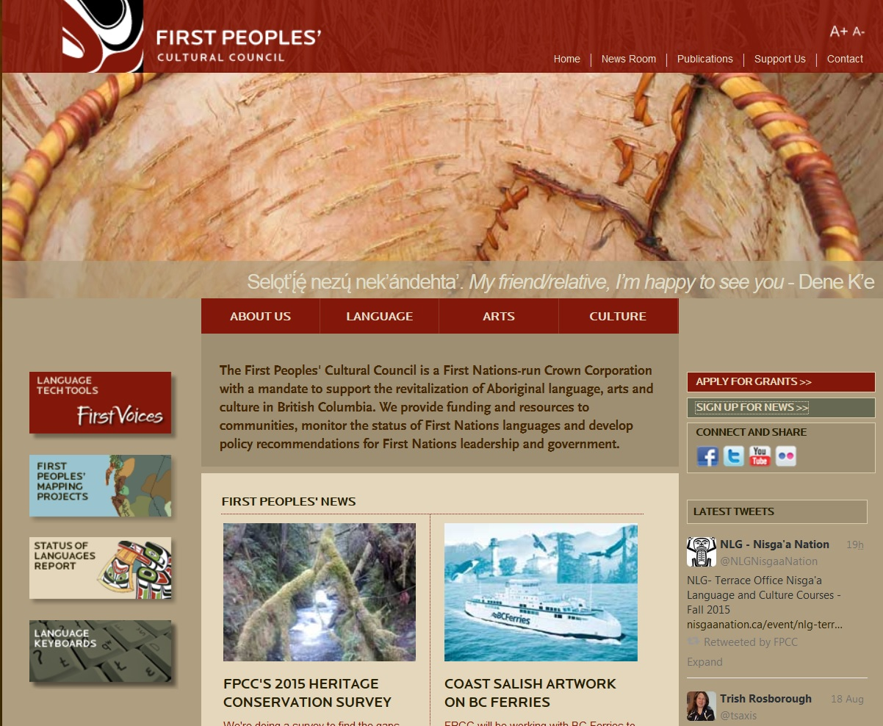
Get the Information
www.fpcc.ca
Sign Up for News
Call us to find out more information about each program, to get an application form, and for support writing an application:
250-652-5952
Notes:
FPCC is unique in Canada
Our legislation supports the creation of the organization and provides us with a mandate
We are the delivery agent for funding for arts, language and FirstVoices
Resource and materials development –
A Guide to Language Policy and Planning for B.C. First Nations Communities
B.C.’s Master-Apprentice Language Program
Artist Grant Proposal Writing Handbook
Advocacy: write papers and publish reports - Report on the Status of BC First Nations Languages

Slide 7




Contact Us!
Aliana Parker
Language Revitalization Program Specialist
Tel: 250-652-5952
aliana@fpcc.ca
www.fpcc.ca
www.firstvoices.com
Notes:
FPCC is unique in Canada
Our legislation supports the creation of the organization and provides us with a mandate
We are the delivery agent for funding for arts, language and FirstVoices
Resource and materials development –
A Guide to Language Policy and Planning for B.C. First Nations Communities
B.C.’s Master-Apprentice Language Program
Artist Grant Proposal Writing Handbook
Advocacy: write papers and publish reports - Report on the Status of BC First Nations Languages

